Slide 1
Making Transformation Work for General Practice
Dr Darren Tymens
GP, Chair Richmond General Practice Alliance

Slide 2
Part One: Federations and the RGPA
Dr Darren Tymens
GP, Chair Richmond General Practice Alliance

Slide 3
NHS in 2017
Not enough money in the system
What money there is, isn’t always being spent most efficiently
The system probably isn’t set up right, but is very difficult to change
The DOH and NHSE wants to see change, but isn’t sure what change it wants to see

Slide 4
General Practice in 2017
Struggling!
Rising patient expectations
Rising demand for appointments
Reduced real resources, and negligible core funding increases
Ageing population, so more people have more diseases
No more GMS contracts – all APMS
Workforce crisis (GPs, Nurses, PMs)
Looking for Plan B

Slide 5
Federation Models
Not all Federations are the same
Who owns them?
Partners? Shareholders? Practices?
How much autonomy remains?
At practice level? At GP level?
How are they led?
Consensual or Directive?

Slide 6
Federation Models
Not all Federations are the same
How much control do GPs and Practices have over them?
Who tells who what to do?
How do you influence direction?
How do you replace people?
Where is their functional geography?
Focused and coherent, or distributed?
What are their goals?

Slide 7
Federation Goals
Backroom Support
HR, staff training, finance and accounts, bulk buying
Management and administrative merger
Mergers
‘Superpractices’
Generate Investment
New opportunities to attract investment

Slide 8
Federation Goals
Greater investment in general practice
No sign of increased core investment
Better terms and conditions for staff
This is how we solve the recruitment crisis
Greater say in the system
We need to be sat as equals at the big tables

Slide 9
What do Federations need to Offer Commissioners?
To solve a problem
The sustainability of general practice
To deliver care at scale
An alternative to hospital care
To shift care into the community
Better, faster, safer and cheaper

Slide 10
What happens if we do nothing?
No sign of a new contract
Is there a plan to replace us?
Are we being allowed to wither?
What is the future of
the profession?
traditional general practice?
practices bedded in communities?

Slide 11
Richmond in 2014…
30 unhappy practices
Increased demand
Years of underinvestment
Little influence over CCG
Dominant hospitals
Plan to create an Integrated Care Organisation
Without general practice
As a competitor or alternative to general practice?

Slide 12
Our Response
Acted together to stop ICO
First time ever
Response of NHSE
Telling off
Interim CEO
Formed a Federation October 2014
All remaining 28 practices
Covering whole 205K population

Slide 13
What happened in Richmond?
Formed Company Limited by Shares Oct 2014
£1 per patient investment = £205K
Formed Board
Set up Localities
Started to meet regularly…

Slide 14
What happened in Richmond?
PMCF
You cannot transform without investment
Hubs
That worked for us and our patients
New terms and conditions: 15 mins
Flying RAT, Apps, Screens
IT integration - interoperability
Opened up new opportunities
Retained control of patient information

Slide 15
What happened in Richmond?
Outcomes Based Commissioning
Attempt at an ACO collapsed
Creation of RCHiP
New Care Pathways
Community Hubs – eg diabetes
Increased LCS role and investment
Pharmacy Contract

Slide 16
What happened in Richmond?
Physio First
Pharmacy First
Mental Health OBC Project
Greater support for practices
Management input to struggling practices
Estates help
Staff Training
HR contracts

Slide 17
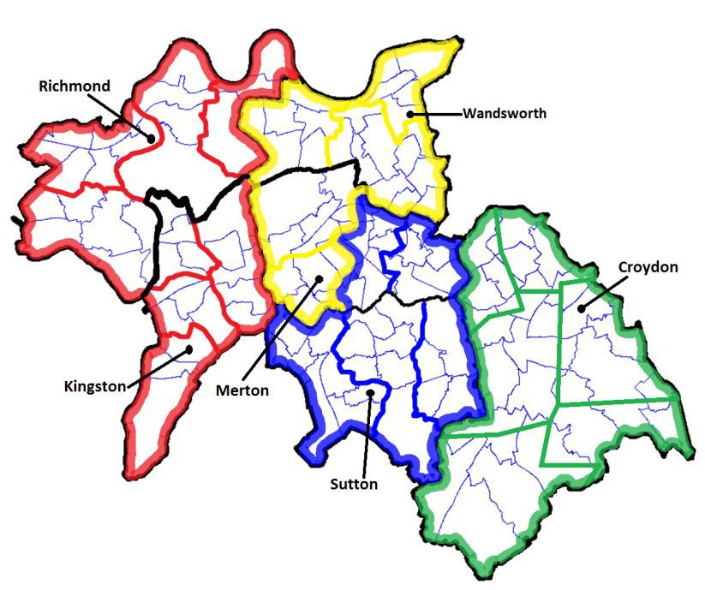
What happened in Richmond?
SWL Sister Federations
Kingston
Wandsworth
Sutton
Merton
Croydon
Formed a Collaborative
Cover 97% practices in SWL
Seat at the STP Table (Part 2)

Slide 18
Learning from Richmond
Stimulus
Reason to form
Positive and/or negative
Values
Know what you are doing and why
Support
You need a supportive CCG or a lottery win
Federation Model
Collegiate
Consensual
Place-based

Slide 19
Learning from Richmond
Three stages of Federations
Set up
Journey to Sustainability
Established Federation
Don’t be afraid to be business-like
If you are too nice you will fail
Don’t accept things can’t be done
They usually can

Slide 20
Learning from Richmond
Communicate, communicate, communicate
With your GPs
With your practices
With your patients
With your commissioners
Take responsibility for delivery
Stand up in front of your peers
Be accountable
Be prepared to step away if things aren’t going well

Slide 21
Learning from Richmond
It is difficult to achieve anything without a supportive commissioner
But not impossible: lots of things remain within your control
If you are not getting anywhere, consider alternative approaches to the relationship?
‘Oderint dum metuant!’

Slide 22
Part Two: A glimpse of a better, more sustainable future?
Dr Darren Tymens
GP, Chair Richmond General Practice Alliance

Slide 23
RGPA: 5 Levels of Care
Pre-practice level
Self care
Supported by the third and charitable sector
Supported by integrated social care
Supported by Pharmacists
Direct access to Physios
Direct access to MH support

Slide 24
RGPA: 5 Levels of Care
Practice Level
traditional general practice
lifelong relationships with patients
rooted in their communities
supported by a Federation

Slide 25
RGPA: 5 Levels of Care
Locality Level 1 (30-50K)
Practices working together to deliver at scale
Integrated multidisciplinary teams

Slide 26
RGPA: 5 Levels of Care
Locality Level 2 (30-200k)
Practices working together in Joint Ventures with community services to deliver a much greater range of services
All of outpatients?

Slide 27
RGPA: 5 Levels of Care
Hospital Level
Hospitals delivering what only hospitals can
Acute in-patient care to the very sick
ITU
surgery
complex diagnostics

Slide 28
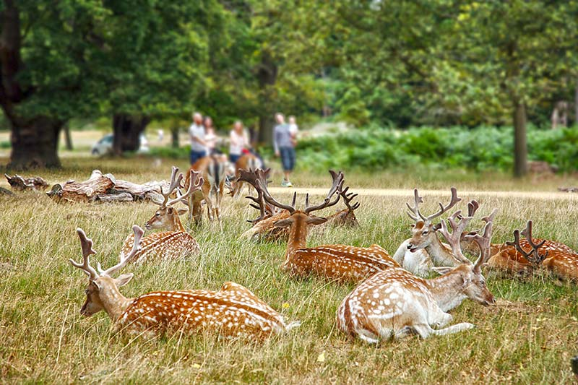
The End

